Slide 1
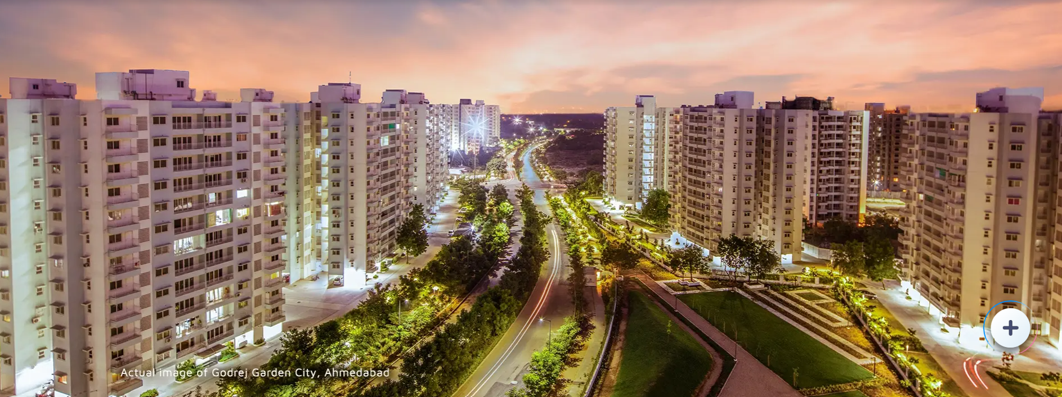
Employee Login

Slide 2
Employee Login
Employee Login
Password
Go

Slide 3
Employee Login
Employee Login
L1 Employee
L1 Employee@gmail.com
L2 Employee@gmail.com
Password
L3 Employee@gmail.com
L4 Employee@gmail.com
L5 Employee@gmail.com
Admin
Go

Slide 4
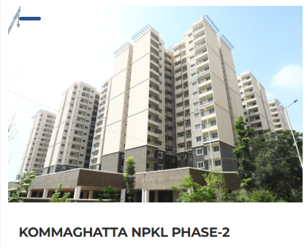
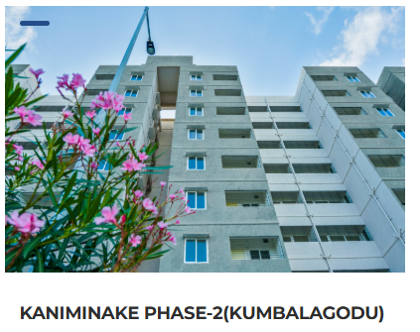
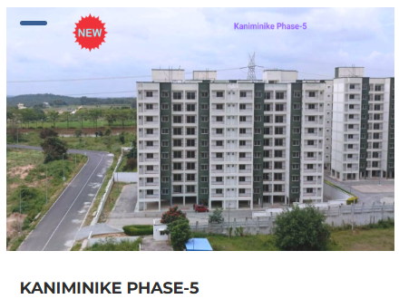
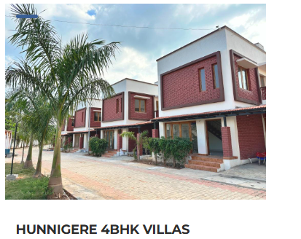
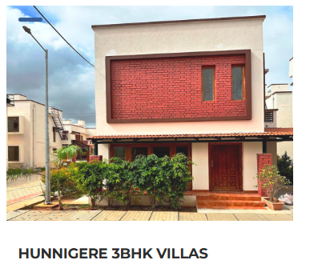
Home
How to Buy
FAQs
Grievance
Login
Price Starts from – Rs 70 Lakhs
Click here for more details
Price Starts from – Rs 50 Lakhs
Click here for more details
Price Starts from – Rs 80 Lakhs
Click here for more details
Price Starts from – Rs 70 Lakhs
Click here for more details
Price Starts from – Rs 70 Lakhs
Click here for more details

Slide 5
Home
How to Buy
FAQs
Grievance
Login
 | Project Highlights | Amenities | Gallery | Videos | Mater Plan | Price | Location
This project is a beautifully designed residency than spans over a prime land of sixty acres located at the Golf Course Extension Road in Bidadi, Bangalore. The breath-taking project is set out to be the most dominating premium residency standing over at a magnanimous height of two hundred meters that is determined to rule the skylines of the region. Flanked by acres of the golf course and landscaped greens at the nexus of a cosmopolitan the neighborhood, these residential blocks rests at Bangalore’s most coveted location. It is connected to the most inspired destinations for business, education, culture, and cuisine. No matter where you are in the city, you see your home.
Land Area
4 Acres, 14 Guntas
Type
3.5 BHK and 4 BHK
Units
206
Super Built-Up Area
272.47 Sq.m. - 358.77 Sq.m.
(2933 Sq.ft. - 3862 Sq.ft.)
Unit Carpet Area
149.77 Sq.m. - 203.14 Sq.m.
(1612 Sq.ft. - 2187 Sq.ft.)
Book a Flat

Slide 6
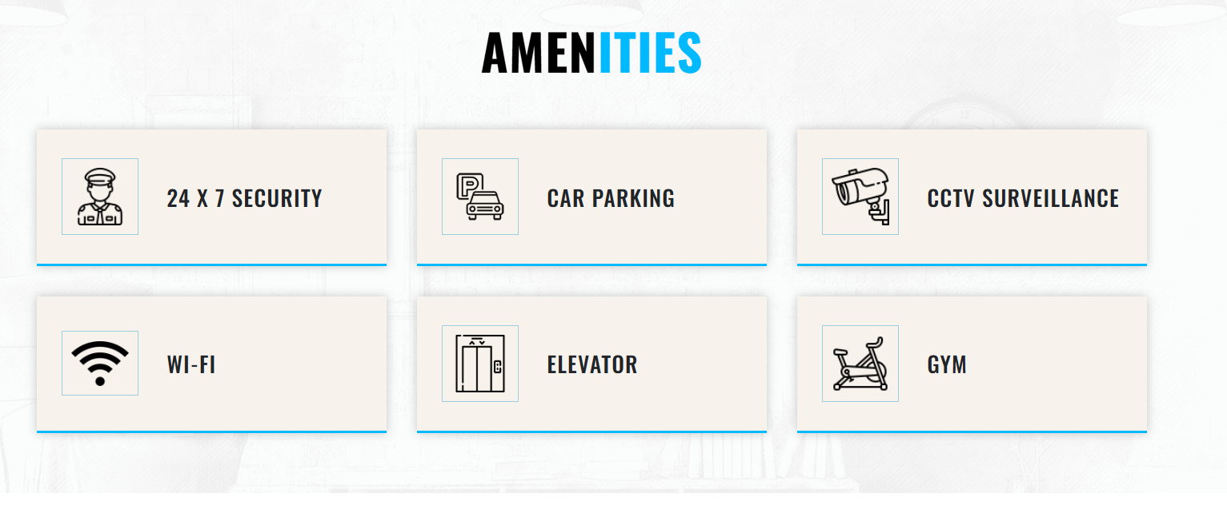
Home
How to Buy
FAQs
Grievance
Login
 | Project Highlights | Amenities | Gallery | Videos | Mater Plan | Price | Location
Book a Flat

Slide 7
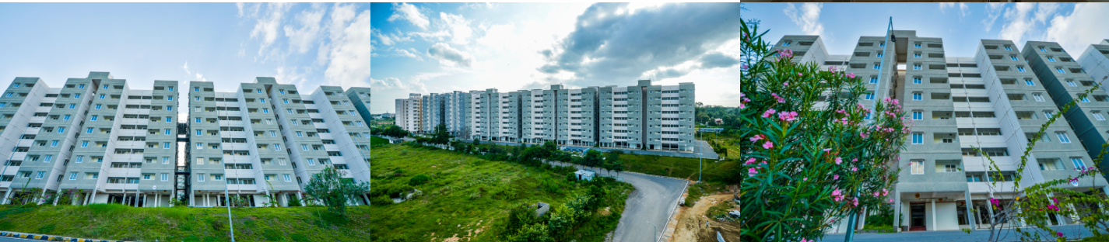
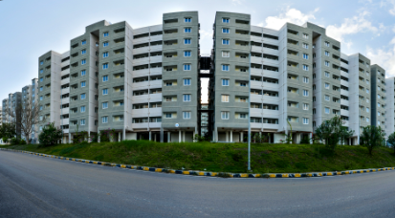
Home
How to Buy
FAQs
Grievance
Login
 | Project Highlights | Amenities | Gallery | Videos | Mater Plan | Price | Location
Book a Flat

Slide 8
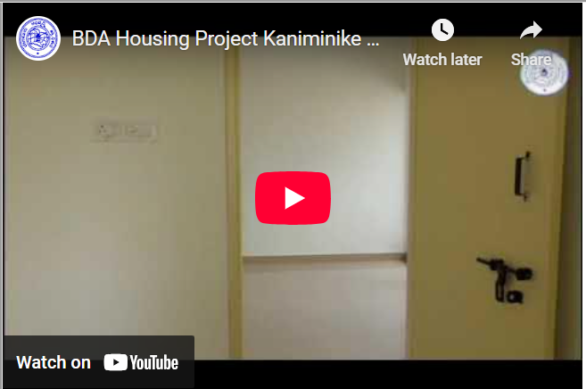
Home
How to Buy
FAQs
Grievance
Login
 | Project Highlights | Amenities | Gallery | Videos | Mater Plan | Price | Location
Book a Flat

Slide 9
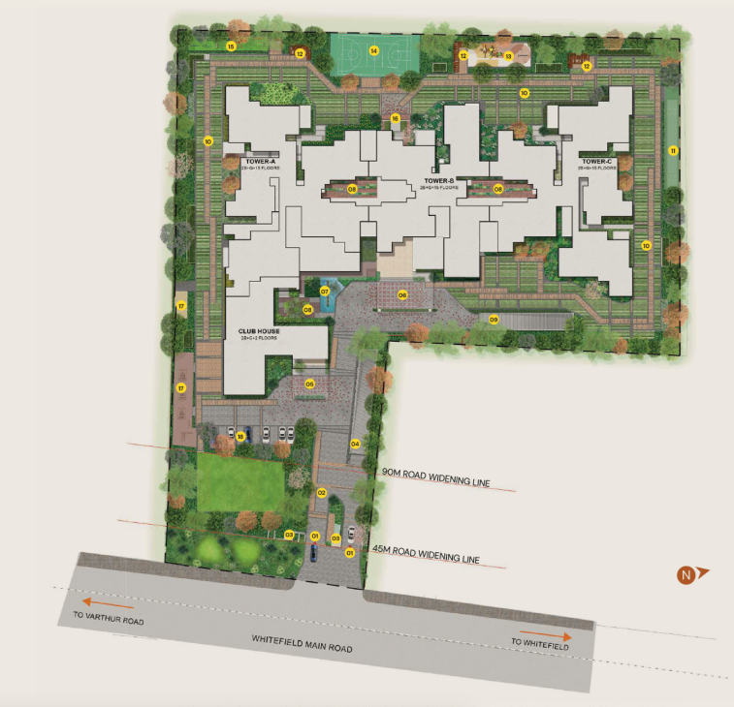
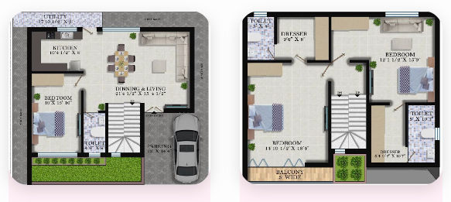
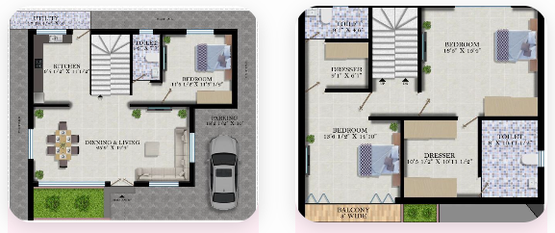
Home
How to Buy
FAQs
Grievance
Login
 | Project Highlights | Amenities | Gallery | Videos | Mater Plan | Price | Location
Book a Flat

Slide 10
Home
How to Buy
FAQs
Grievance
Login
 | Project Highlights | Amenities | Gallery | Videos | Mater Plan | Price | Location
Type | Size | Flat Price | Amenities Charges | Total Cost
1 BHK | 550 Sq Ft | Rs 12,50,000 | Rs 2,50,000 | Rs 15,00,000
2 BHK | 990 Sq Ft | Rs 20,50,000 | Rs 2,50,000 | Rs 23,00,000
3 BHK | 1200 Sq Ft | Rs 30,50,000 | Rs 2,50,000 | Rs 33,00,000
Book a Flat

Slide 11
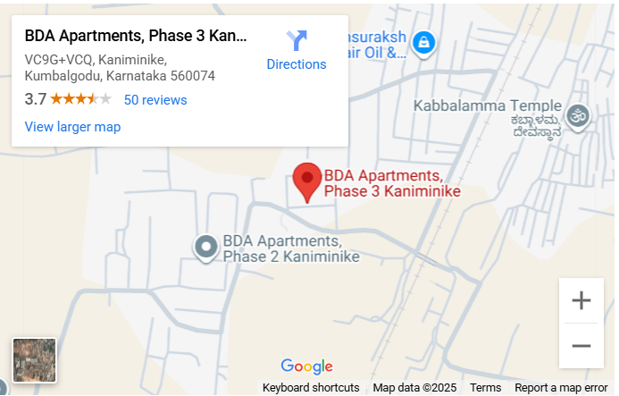

Home
How to Buy
FAQs
Grievance
Login
 | Project Highlights | Amenities | Gallery | Videos | Mater Plan | Price | Location
2 Km to National Highway
Close to National School
10 min to Forum Mall
10 min to Narayana Hrudayalaya
Book a Flat

Slide 12
Home
How to Buy
FAQs
Grievance
Login
10th Floor |  | Available | Not Available | Available | Available
9th Floor |  | Not Available | Available | Not Available | Not Available
8th Floor |  | Available | Available | Available | Available
7th Floor |  | Not Available | Available | Not Available
6th Floor |  | Available | Not Available | Not Available | Available
5th Floor |  | Not Available | Not Available | Available | Not Available
4th Floor |  | Available | Available | Available | Available
3rd Floor |  | Not Available | Available | Available | Available
2nd Floor |  | Available | Not Available | Available | Available
1st Floor |  | Available | Not Available | Available | Not Available
Ground Floor |  | Not Available | Available | Not Available | Available
 |  | 1 BHK |  |  |  |  | 2 BHK |  |  |  |  | 3 BHK |  |  |  |  | 4 BHK
Available
Block 1
Block 2
Block 3
Block 4

Slide 13
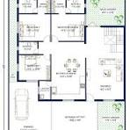
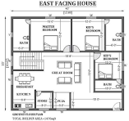
Home
FAQs
Grievance
Login
How to Buy
Login
East facing Built-up Plan
West facing Built-up Plan
Photo Gallery
Cost of Possession
Photo Gallery
Cost of Possession
No 701 |  | No 703 | No 704 | No 705 | No 706
Available Flats – Select the Flat number to book
No 707 | No 708 | No 709 | No 710 | No 711 | No 712
Available Flats – Select the Flat number to book
No 702
AMENITIES | BASEMENT AND STILT LEVEL CAR PARKING, POWER SUPPLY, WATER SUPPLY, CHILDREN'S PLAY AREA, TWO LIFT, TWO STAIRCASES IN EACH BLOCK, COMMON AREA LIFT WITH GENERATOR BACKUP
TYPE OF STRUCTURE: | CAST INSITU SHEAR WALL CONSTRUCTION(MILAN TECHNOLOGY)
FLOORING: | VITRIFIED FLOORING (2X2) FOR LIVING, BEDROOM. ANTI-SKID TILE FOR TOILET
COMMON AREA FLOORING: | HASSAN GREEN/GRANITE
STAIRCASE: | HASSAN GREEN/GRANITE
DADO: | GLAZED TILE FOR BATHROOM AND TOILET
DOORS: | FLUSH DOORS
To purchase a flat, please register and create a login credentials by providing Adhaar enabled mobile number and complete Adhaar based KYC

Slide 14
FAQs
Grievance
Login
Home
How to Buy
Login
East facing Built-up Plan
West facing Built-up Plan
Built up Area | 1300 Sq ft
Cost per Sq Feet | Rs 5000/-
Total Cost of the Flat | Rs 65,00,000/-
Amenities Charges | Rs 2,50,000/-
Legal and administration Charges | Rs 1,00,000/-
Total Cost of Purchase | Rs 68,50,000/-
Registration Charges are extra and subjected to change as per Karnataka Govt policy
Booking Charges (Except SC/ST) | Rs 2,50,000/-
Booking Charges (SC/ST) | Rs 1,00,000/-
Photo Gallery
Cost of Possession
Photo Gallery
Cost of Possession
No 701 | No 702 | No 703 | No 704 | No 705 | No 706
Available Flats
No 707 | No 708 | No 709 | No 710 | No 711 | No 712
Available Flats
AMENITIES | BASEMENT AND STILT LEVEL CAR PARKING, POWER SUPPLY, WATER SUPPLY, CHILDREN'S PLAY AREA, TWO LIFT, TWO STAIRCASES IN EACH BLOCK, COMMON AREA LIFT WITH GENERATOR BACKUP
TYPE OF STRUCTURE: | CAST INSITU SHEAR WALL CONSTRUCTION(MILAN TECHNOLOGY)
FLOORING: | VITRIFIED FLOORING (2X2) FOR LIVING, BEDROOM. ANTI-SKID TILE FOR TOILET
COMMON AREA FLOORING: | HASSAN GREEN/GRANITE
STAIRCASE: | HASSAN GREEN/GRANITE
DADO: | GLAZED TILE FOR BATHROOM AND TOILET
DOORS: | FLUSH DOORS
Ok

Slide 15
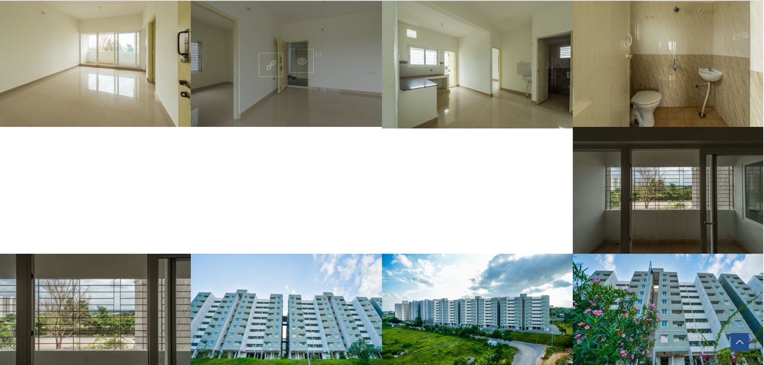
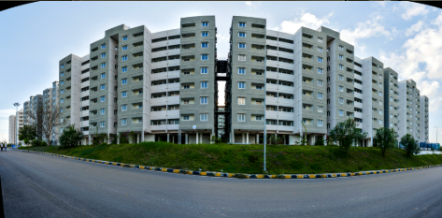
Home
FAQs
Grievance
Login
How to Buy
Login

Slide 16
Home
How to Buy
FAQs
Grievance
Login
Already Registered?
Mobile Number
OTP
OR
Provide Adhaar enabled mobile number
Register
OTP

Slide 17
Home
How to Buy
FAQs
Grievance
Profile
Purchase History
KYC Status
Not Approved
Type | Project Name | Date of Booking | Current Status | Know More
Name
More Details
Gender
Date of Birth
More Details
Verified Email
Query History
Verified Mobile
Respond
Notifications
eKYC | Complete Your KYC to book a flat
Raise New Query

Slide 18
Home
How to Buy
FAQs
Grievance
Profile
Purchase History
KYC Status
Approved
Type | Project Name | Date of Booking | Current Status | Know More
Flat | Kannimanike Phase 1 | 1 Jan 2025 | Booked
Villa | Hunnigere | 1 Jan 2023 | Registration Complete
Name
Mr ABDCFA
More Details
Gender
Male
Date of Birth
20/Feb/1960
More Details
Verified Email
abcded@gmail.com
Query History
Verified Mobile
9874563210
Kannimanike Phase 1 | You have to see the FAQ . All info avalable
Hunnigere | Your payment is yet to be reconciled.
Notifications
Attachment
Respond
Receipt | 2nd Installment Receipt available
Attachment
Respond
Raise New Query

Slide 19
Home
How to Buy
FAQs
Grievance
Profile
Purchase History
KYC Status
Approved
Subject
Approved
Type | Project Name | Date of Booking | Current Status | Know More
Flat | Kannimanike Phase 1 | 1 Jan 2025 | Booked
Villa | Hunnigere | 1 Jan 2023 | Registration Complete
Name
Mr ABDCFA
Content
Mr ABDCFA
More Details
Gender
Male
Date of Birth
20/Feb/1960
More Details
Verified Email
abcded@gmail.com
Query History
Verified Mobile
9874563210
Attachment
Male
Kannimanike Phase 1 | You have to see the FAQ . All info avalable
Hunnigere | Your payment is yet to be reconciled.
Attachment
Respond
Attachment
Respond
Send
Raise New Query

Slide 20
Home
How to Buy
FAQs
Grievance
Profile
Subject
Approved
Content
Mr ABDCFA
Attachment
Male

Slide 21
Home
How to Buy
FAQs
Grievance
Profile
Apartment / Villa | Kammaghatta Phase 2
BHK | 3 BHK
Built up Area | 1300 Sq ft
Block | 1st Block
Floor | 7th Floor
Flat Number | No 701
Date of Booking | 1 Jan 2025
Last date to complete payment without penalty | 1 Apr 2025
Total Payment done | Rs 17,50,000
Remaining amount | Rs 15,00,000
Purchaser Name
Payment History
Payment Receipts
Documents Received
Purchase 1 | Mr ABMDCD EFGE
Purchase 2 | Ms EGETG gdatesaete
Payment type | Date of payment | Amount | Mode of Payment
Booking | 1 Jan 2025 | Rs 2,50,000 | Credit Card
1st Installment | 1 Feb 2025 | Rs 10,00,000 | Net Bank
2nd Installment | 25 Mar 2025 | Rs 5,00,000 | UTR Upload
Receipt 1
Receipt 2
Receipt 3
Pay Installment
NOC
Allotment Letter
Sale Deed Copy
Registered Sale Deed
Upload

Slide 22
Home
How to Buy
FAQs
Grievance
Profile
Apartment / Villa | Kammaghatta Phase 2
BHK | 3 BHK
Built up Area | 1300 Sq ft
Block | 1st Block
Floor | 7th Floor
Flat Number | No 701
Date of Booking | 1 Jan 2025
Last date to complete payment without penalty | 1 Apr 2025
Total Payment done | Rs 32,50,000
Registration Date | 1 May 2025
Purchaser Name
Payment History
Payment Receipts
Documents Received
Purchase 1 | Mr ABMDCD EFGE
Purchase 2 | Ms EGETG gdatesaete
Payment type | Date of payment | Amount | Mode of Payment
Booking | 1 Jan 2025 | Rs 2,50,000 | Credit Card
1st Installment | 1 Feb 2025 | Rs 10,00,000 | Net Bank
2nd Installment | 25 Mar 2025 | Rs 5,00,000 | UTR Upload
Receipt 1
Receipt 2
Receipt 3
NOC
Allotment Letter
Registered Sale Deed
Registered Sale deed
Possession Certificate
Sale Deed Copy
Ok

Slide 23
Home
Flat Purchase
How to Buy
FAQs
Grievance
Profile
Complete your profile details and eKYC to purchase a flat / Villa
Adhaar Number
Name
OTP
Gender
PAN Number
Date of Birth
Verify
Verified Email
Email ID
Verified Mobile
Verify
Check OTP sent to the email and type
Address
Proceed

Slide 24
Home
Flat Purchase
How to Buy
FAQs
Grievance
Profile
Complete your profile details and eKYC to purchase a flat / Villa
Your eKYC is verified through Adhaar and PAN.
You can continue to book a flat
Adhaar Number
Name
OTP
Gender
PAN Number
Date of Birth
Verify
Verified Email
Email ID
Verified Mobile
Verify
Proceed to book
Go to home page
Check OTP sent to the email and type
Address

Slide 25
Home
Flat Purchase
How to Buy
FAQs
Grievance
Profile
Complete your profile details and eKYC to purchase a flat / Villa
Your DigiLocker authentication is failed due to mismatch in the Adhaar and PAN.
You can upload the scanned copy of Front and Back view of Adhaar and PAN for verification by the authority.
Once verified, you will be notified over mobile number for you to proceed to the flat booking.
Adhaar Number
Name
OTP
Gender
PAN Number
Date of Birth
Verify
Verified Email
Email ID
Verified Mobile
Verify
Upload the document
Go to home page
Check OTP sent to the email and type
Address

Slide 26
Home
Flat Purchase
How to Buy
FAQs
Grievance
Profile
Adhaar Front View
Adhaar Back View
PAN Front View
PAN Back View
Name As per Adhaar
Date of Birth
PAN Number
Verified Email
Gender
Mobile
Email Id
Address
Upload

Slide 27
Home
How to Buy
FAQs
Grievance
Profile
10th Floor |  | Available | Not Available | Available | Available
9th Floor |  | Not Available | Available | Not Available | Not Available
8th Floor |  | Available | Available | Available | Available
7th Floor |  | Not Available | Available | Not Available
6th Floor |  | Available | Not Available | Not Available | Available
5th Floor |  | Not Available | Not Available | Available | Not Available
4th Floor |  | Available | Available | Available | Available
3rd Floor |  | Not Available | Available | Available | Available
2nd Floor |  | Available | Not Available | Available | Available
1st Floor |  | Available | Not Available | Available | Not Available
Ground Floor |  | Not Available | Available | Not Available | Available
 |  | 1 BHK |  |  |  |  | 2 BHK |  |  |  |  | 3 BHK |  |  |  |  | 4 BHK
Available
Block 1
Block 2
Block 3
Block 4

Slide 28
Home
How to Buy
FAQs
Grievance
Profile
East facing Built-up Plan
West facing Built-up Plan
Photo Gallery
Cost of Possession
Photo Gallery
Cost of Possession
No 701 |  | No 703 | No 704 | No 705 | No 706
Available Flats
No 707 | No 708 | No 709 | No 710 | No 711 | No 712
Available Flats
No 702
AMENITIES | BASEMENT AND STILT LEVEL CAR PARKING, POWER SUPPLY, WATER SUPPLY, CHILDREN'S PLAY AREA, TWO LIFT, TWO STAIRCASES IN EACH BLOCK, COMMON AREA LIFT WITH GENERATOR BACKUP
TYPE OF STRUCTURE: | CAST INSITU SHEAR WALL CONSTRUCTION(MILAN TECHNOLOGY)
FLOORING: | VITRIFIED FLOORING (2X2) FOR LIVING, BEDROOM. ANTI-SKID TILE FOR TOILET
COMMON AREA FLOORING: | HASSAN GREEN/GRANITE
STAIRCASE: | HASSAN GREEN/GRANITE
DADO: | GLAZED TILE FOR BATHROOM AND TOILET
DOORS: | FLUSH DOORS
To purchase a flat, please register and create a login credentials by providing Adhaar enabled mobile number and complete Adhaar based KYC

Slide 29
Home
How to Buy
FAQs
Grievance
Profile
10th Floor |  | Available | Not Available | Available | Available
9th Floor |  | Not Available | Available | Not Available | Not Available
8th Floor |  | Available | Available | Available | Available
7th Floor |  | Not Available | Available | Not Available
6th Floor |  | Available | Not Available | Not Available | Available
5th Floor |  | Not Available | Not Available | Available | Not Available
4th Floor |  | Available | Available | Available | Available
3rd Floor |  | Not Available | Available | Available | Available
2nd Floor |  | Available | Not Available | Available | Available
1st Floor |  | Available | Not Available | Available | Not Available
Ground Floor |  | Not Available | Available | Not Available | Available
 |  | Parking in 1 BHK |  |  |  |  | Parking in 2 BHK |  |  |  |  | Parking in 3 BHK |  |  |  |  | Parking in 4 BHK
Available
Block 1
Block 2
Block 3
Block 4

Slide 30
Home
How to Buy
FAQs
Grievance
Profile
Is it Single Owner or Joint Owner ship
Single Owner
Joint Owner ship
Number of Owners
2
Complete all Co-owners eKYC to purchase a flat / Villa
Adhaar Number
Adhaar Number
OTP
OTP
PAN Number
PAN Number
Verify
Verify
Email ID
Email ID
Verify
Check OTP sent to the email and type
Verify
Check OTP sent to the email and type
Phone ID
Phone ID
Verify
Verify
Address
Address
Save and Proceed

Slide 31
Home
How to Buy
FAQs
Grievance
Profile
Details of the Flat Selected
Details of the Owner
Apartment / Villa | Kammaghatta Phase 2
BHK | 3 BHK
Built up Area | 1300 Sq ft
Block | 1st Block
Floor | 7th Floor
Flat Number | No 701
Total Cost of Purchase | Rs 68,50,000/-
Booking Charges (Except SC/ST) | Rs 2,50,000/-
Booking Charges (SC/ST) | Rs 1,00,000/-
Purchaser Name | Mr ABCD Mr CDEF
Email ID
Phone Number
Address
Purchase 1
Purchase 2
Purchase 3
Purchase 1
Purchase 2
Purchase 3
Purchase 1
Purchase 2
Purchase 3
Purchase 1
Purchase 2
Purchase 3
Are you come under SC/ST Category?
No
Yes
Category certification Number
Verify
Save and Proceed

Slide 32
Home
How to Buy
FAQs
Grievance
Profile
Select the type of Payment Option
Booking Amount | Rs 2,50,000/-
Credit Card | Paytm Google Pay Phone Pay Other Ways Enter UPI ID
UPI Payment
Online Banking
Enter UTR Details if paid through bank branch | Date of Payment Bank Nam Branch Amount Paid UTR Number
Upload Scanned Receipt
Upload

Slide 33
Payment of Rs 2,50,000/- is successful. Booking of Flat is Successful. Details are as follows
Apartment / Villa | Kammaghatta Phase 2
BHK | 3 BHK
Built up Area | 1300 Sq ft
Block | 1st Block
Floor | 7th Floor
Flat Number | No 701
Total Cost of Purchase | Rs 68,50,000/-
Booking Amount Paid | Rs 2,50,000/-
Balance Amount to be paid | Rs 66,00,000/-
Last Date to pay full amount | 15/Dec/2025
Purchaser Name | Mr ABCD Mr CDEF
Email ID
Phone Number
Address
Purchase 1
Purchase 2
Purchase 3
Purchase 1
Purchase 2
Purchase 3
Purchase 1
Purchase 2
Purchase 3
Purchase 1
Purchase 2
Purchase 3
OK
Download the Receipt

Slide 34
Thanks for sharing the payment details. will verify the payment with in 7 working days and update the Status of Booking. You will be notified over email and phone number given.
Apartment / Villa | Kammaghatta Phase 2
BHK | 3 BHK
Built up Area | 1300 Sq ft
Block | 1st Block
Floor | 7th Floor
Flat Number | No 701
Total Cost of Purchase | Rs 68,50,000/-
Booking Amount Paid | Rs 2,50,000/-
Balance Amount to be paid | Rs 66,00,000/-
Last Date to pay full amount | 15/Dec/2025
Purchaser Name | Mr ABCD Mr CDEF
Email ID
Phone Number
Address
Purchase 1
Purchase 2
Purchase 3
Purchase 1
Purchase 2
Purchase 3
Purchase 1
Purchase 2
Purchase 3
Purchase 1
Purchase 2
Purchase 3
OK

Slide 35
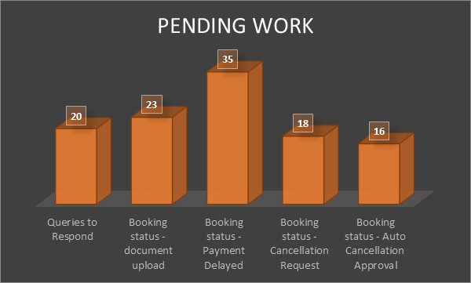
Home
Level 1 employee Dashboard
Logout
Pending Work
Login Id | Date of Query | Subject
9874563218 | 1 Jan 2025 | NoC is pending
3214569872 | 1 Jan 2025 | Possession certificate
1598753246 | 1 Jan 2025 | Unable to login
2587413698 | 1 Jan 2025 | Not able to book
Respond
Respond
Respond
Respond
Review Booking Status
Go
Review Documents
Go
Manage Existing Project
Go
Create New Project

Slide 36
Home
Level 1 employee Dashboard
Logout
Pending Work
Query Response
Login Id | Date of Query | Subject
9874563218 | 1 Jan 2025 | NoC is pending
3214569872 | 1 Jan 2025 | Possession certificate
1598753246 | 1 Jan 2025 | Unable to login
2587413698 | 1 Jan 2025 | Not able to book
Respond
Respond
Respond
Respond
Review Booking Status
Kommaghatta NPKL Phase 1
Kommaghatta NPKL Phase 2
Hunnigere 4 BHK
Hunnigere 3 BHK
Kaniminake 5 Phase
Kumbalgoad Phase 1
Go
Review Documents
Go
Manage Existing Project
Go
Create New Project

Slide 37
Home
Level 1 employee Dashboard
Logout
Pending Work
Query Response
Login Id | Date of Query | Subject
9874563218 | 1 Jan 2025 | NoC is pending
3214569872 | 1 Jan 2025 | Possession certificate
1598753246 | 1 Jan 2025 | Unable to login
2587413698 | 1 Jan 2025 | Not able to book
Respond
Respond
Respond
Respond
Review Booking Status
Go
Review Documents
Go
Manage Existing Project
Kommaghatta NPKL Phase 1
Kommaghatta NPKL Phase 2
Hunnigere 4 BHK
Hunnigere 3 BHK
Kaniminake 5 Phase
Kumbalgoad Phase 1
Go
Create New Project

Slide 38
Home
Level 1 employee Dashboard
Logout
Pending Work
Query Response
Login Id | Date of Query | Subject
9874563218 | 1 Jan 2025 | NoC is pending
3214569872 | 1 Jan 2025 | Possession certificate
1598753246 | 1 Jan 2025 | Unable to login
2587413698 | 1 Jan 2025 | Not able to book
Respond
Respond
Respond
Respond
Review Booking Status
Go
Review Documents
Go
Manage Existing Project
Go
Create New Project

Slide 39
Home
Level 1 employee Dashboard
Logout
Kommaghatta NPKL Phase 1
Item | Status
Project Video | Uploaded
Individual Flat Photo Gallery | Uploaded
Individual Flat floor plan | Uploaded
Flat Cost | Uploaded
Amenities | Uploaded
Location | Uploaded
Flat Construction Details | Uploaded
Edit
Edit
Edit
Edit
Edit
Edit
Edit

Slide 40
Home
Level 1 employee Dashboard
Logout
Kommaghatta NPKL Phase 1
Item | Status
Project Video | Uploaded
Individual Flat Photo Gallery | Uploaded
Individual Flat floor plan | Uploaded
Flat Cost | Uploaded
Amenities | Uploaded
Location | Uploaded
Flat Construction Details | Uploaded
Edit
Upload
Edit
Edit
Edit
Edit
Edit
Edit

Slide 41
Home
Level 1 employee Dashboard
Logout
Kommaghatta NPKL Phase 1
Item | Status
Project Video | Uploaded
Individual Flat Photo Gallery | Uploaded
Individual Flat floor plan | Uploaded
Flat Cost | Uploaded
Amenities | Uploaded
Location | Uploaded
Flat Construction Details | Uploaded
Edit
Upload
Edit
Edit
Edit
Edit
Edit
Edit
Save

Slide 42
Home
Level 1 employee Dashboard
Logout
Kommaghatta NPKL Phase 1
Item | Status
Project Video | Uploaded
Individual Flat Photo Gallery | Uploaded
Individual Flat floor plan | Uploaded
Flat Cost | Uploaded
Amenities | Uploaded
Location | Uploaded
Flat Construction Details | Uploaded
Block
Edit
Edit
Floor
Edit
Direction Facing
Edit
Edit
Edit
Edit
Edit

Slide 43
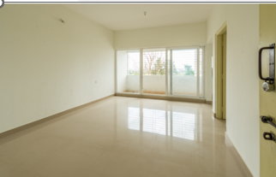
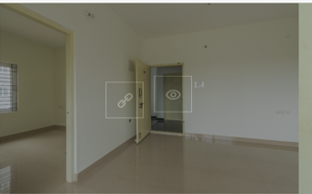
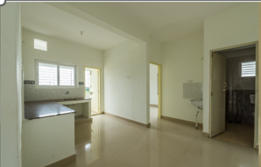
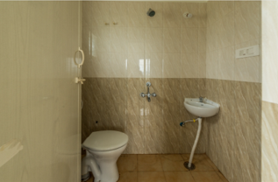
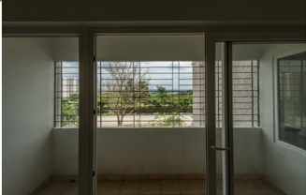
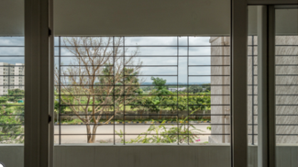
Home
Level 1 employee Dashboard
Logout
Kommaghatta NPKL Phase 1
Upload Photo
Upload Video
Delete Selected
Save

Slide 44
Home
Level 1 employee Dashboard
Logout
Kommaghatta NPKL Phase 1
Item | Status
Project Video | Uploaded
Individual Flat Photo Gallery | Uploaded
Individual Flat floor plan | Uploaded
Flat Cost | Uploaded
Amenities | Uploaded
Location | Uploaded
Flat Construction Details | Uploaded
Block
Edit
Edit
Floor
Edit
Edit
Edit
Edit
Edit
Edit

Slide 45
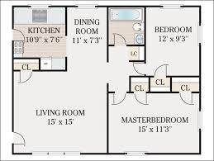
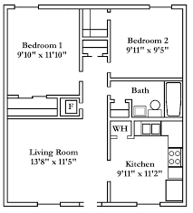
Home
Level 1 employee Dashboard
Logout
Kommaghatta NPKL Phase 1
East Facing
West Facing
Replace Selected Photo

Slide 46
Home
Level 1 employee Dashboard
Logout
Kommaghatta NPKL Phase 1
Built up Area | 1300 Sq ft
Cost per Sq Feet | Rs 5000/-
Total Cost of the Flat | Rs 65,00,000/-
Amenities Charges | Rs 2,50,000/-
Legal and administration Charges | Rs 1,00,000/-
Total Cost of Purchase | Rs 68,50,000/-
Registration Charges are extra and subjected to change as per Karnataka Govt policy
Booking Charges (Except SC/ST) | Rs 2,50,000/-
Booking Charges (SC/ST) | Rs 1,00,000/-
Block
Floor
Direction Facing
Save

Slide 47
Home
Level 1 employee Dashboard
Logout
Kommaghatta NPKL Phase 1
Item | Status
Project Video | Uploaded
Individual Flat Photo Gallery | Uploaded
Individual Flat floor plan | Uploaded
Flat Cost | Uploaded
Amenities | Uploaded
Location | Uploaded
Flat Construction Details | Uploaded
Amenity Description
BASEMENT AND STILT LEVEL CAR PARKING, POWER SUPPLY, WATER SUPPLY, CHILDREN'S PLAY AREA, TWO LIFT, TWO STAIRCASES IN EACH BLOCK, COMMON AREA LIFT WITH GENERATOR BACKUP
Edit
Edit
Basketball Court
Badminton Court
Tennis Court
Edit
Edit
Swimming Pool
Grocery Retail Shop
Health Center
Edit
Club House
Children Play Area
Jogging Park
Edit
Yoga Center
Power Backup
Lifts
Edit
Save

Slide 48
Home
Level 1 employee Dashboard
Logout
Kommaghatta NPKL Phase 1
Item | Status
Project Video | Uploaded
Individual Flat Photo Gallery | Uploaded
Individual Flat floor plan | Uploaded
Flat Cost | Uploaded
Amenities | Uploaded
Location | Uploaded
Flat Construction Details | Uploaded
Edit
Edit
Edit
Edit
Edit
Edit
Edit
Save

Slide 49
Home
Level 1 employee Dashboard
Logout
Kommaghatta NPKL Phase 1
Item | Status
Project Video | Uploaded
Individual Flat Photo Gallery | Uploaded
Individual Flat floor plan | Uploaded
Flat Cost | Uploaded
Amenities | Uploaded
Location | Uploaded
Flat Construction Details | Uploaded
Edit
TYPE OF STRUCTURE: | CAST INSITU SHEAR WALL CONSTRUCTION(MILAN TECHNOLOGY)
FLOORING: | VITRIFIED FLOORING (2X2) FOR LIVING, BEDROOM. ANTI-SKID TILE FOR TOILET
COMMON AREA FLOORING: | HASSAN GREEN/GRANITE
STAIRCASE: | HASSAN GREEN/GRANITE
DADO: | GLAZED TILE FOR BATHROOM AND TOILET
DOORS: | FLUSH DOORS
Edit
Edit
Edit
Edit
Edit
Edit
Save

Slide 50
Home
Level 1 employee Dashboard
Logout
Item | Status
Project Name
Project Video
Individual Flat Photo Gallery
Individual Flat floor plan
Flat Cost
Amenities
Location
Flat Construction Details
Edit
Edit
Edit
Edit
Edit
Edit
Edit
Edit

Slide 51
Project Name
Type of Property
Number of Block

Slide 52
Project Name
Tippagondanahalli Phase 1
Type of Property
FLATS
Number of Block
3
Flats per Floor
BHK
Number of Floor
Block 1
Block 2
Block 3

Slide 53
Project Name
Tippagondanahalli Phase 1
Type of Property
FLATS
Number of Block
3
8th Floor
7th Floor
6th Floor
5th Floor
4th Floor
3rd Floor
2nd Floor
1st Floor
Ground Floor
Direction of Facing |  |  | N | N | S | S |  | E | E | W | W |  | E | E | W | W
Flats per Floor |  |  | 4 |  |  |  |  | 4 |  |  |  |  | 4
BHK |  |  | 1 BHK |  |  |  |  | 2 BHK |  |  |  |  | 3 BHK
Number of Floor |  |  | 6 |  |  |  |  | 8 |  |  |  |  | 8
Block 1
Block 2
Block 3

Slide 54
Project Name
Tippagondanahalli Phase 1
Type of Property
FLATS
Number of Block
3
8th Floor |  |  |  |  |  |  |  | 805 | 806 | 807 | 808 |  | 809 | 810 | 811 | 812
7th Floor |  |  |  |  |  |  |  | 705 | 706 | 707 | 708 |  | 709 | 710 | 711 | 712
6th Floor |  |  | 601 | 602 | 603 | 604 |  | 605 | 606 | 607 | 608 |  | 609 | 610 | 611 | 612
5th Floor |  |  | 501 | 502 | 503 | 504 |  | 505 | 506 | 507 | 508 |  | 509 | 510 | 511 | 512
4th Floor |  |  | 401 | 402 | 403 | 404 |  | 405 | 406 | 407 | 408 |  | 409 | 410 | 411 | 412
3rd Floor |  |  | 301 | 302 | 303 | 304 |  | 305 | 306 | 307 | 308 |  | 309 | 310 | 311 | 312
2nd Floor |  |  | 201 | 202 | 203 | 204 |  | 205 | 206 | 207 | 208 |  | 209 | 210 | 211 | 212
1st Floor |  |  | 101 | 102 | 103 | 104 |  | 105 | 106 | 107 | 108 |  | 109 | 110 | 111 | 112
Ground Floor |  |  | 001 | 002 | 003 | 004 |  | 005 | 006 | 007 | 008 |  | 009 | 010 | 012 | 013
Direction of Facing |  |  | N | N | S | S |  | E | E | W | W |  | E | E | W | W
Flats per Floor |  |  | 4 |  |  |  |  | 4 |  |  |  |  | 4
BHK |  |  | 1 BHK |  |  |  |  | 2 BHK |  |  |  |  | 3 BHK
Number of Floor |  |  | 6 |  |  |  |  | 8 |  |  |  |  | 8
Block 1
Block 2
Block 3
Save

Slide 55
Home
Level 1 employee Dashboard
Logout
Item | Status
Project Name | Updated
Project Video
Individual Flat Photo Gallery
Individual Flat floor plan
Flat Cost
Amenities
Location
Flat Construction Details
Project Name
Tippagondanahalli Phase 1
Edit
Edit
Edit
Edit
Edit
Edit
Edit
Edit

Slide 56
Home
Level 1 employee Dashboard
Logout
Item | Status
Project Name | Updated
Project Video
Individual Flat Photo Gallery
Individual Flat floor plan
Flat Cost
Amenities
Location
Flat Construction Details
Project Name
Tippagondanahalli Phase 1
Edit
Edit
Edit
Edit
Upload
Edit
Edit
Edit
Edit
Save

Slide 57
Home
Level 1 employee Dashboard
Logout
Item | Status
Project Name | Updated
Project Video
Individual Flat Photo Gallery
Individual Flat floor plan
Flat Cost
Amenities
Location
Flat Construction Details
Project Name
Tippagondanahalli Phase 1
Edit
Edit
Edit
Edit
Upload
Edit
Edit
Edit
Edit
Save

Slide 58
Home
Level 1 employee Dashboard
Logout
Item | Status
Project Name | Updated
Project Video | Updated
Individual Flat Photo Gallery
Individual Flat floor plan
Flat Cost
Amenities
Location
Flat Construction Details
Project Name
Tippagondanahalli Phase 1
Edit
Edit
Edit
Edit
Edit
Edit
Edit
Edit

Slide 59
Home
Level 1 employee Dashboard
Logout
Photo Upload
Block
Video Upload
Continue

Slide 60
Home
Level 1 employee Dashboard
Logout
Photo Upload
Block
Block 1
Video Upload
These photo and Video is applicable to these flats
601 | 602 | 603 | 604
501 | 502 | 503 | 504
401 | 402 | 403 | 404
301 | 302 | 303 | 304
201 | 202 | 203 | 204
101 | 102 | 103 | 104
001 | 002 | 003 | 004
Save

Slide 61
Home
Level 1 employee Dashboard
Logout
Photo Upload
Block
Block 1
Video Upload
These photo and Video is applicable to these flats
601 | 602 | 603 | 604
501 | 502 | 503 | 504
401 | 402 | 403 | 404
301 | 302 | 303 | 304
201 | 202 | 203 | 204
101 | 102 | 103 | 104
001 | 002 | 003 | 004
Save
Submit

Slide 62
Home
Level 1 employee Dashboard
Logout
Item | Status
Project Name | Updated
Project Video | Updated
Individual Flat Photo Gallery | Updated
Individual Flat floor plan
Flat Cost
Amenities
Location
Flat Construction Details
Project Name
Tippagondanahalli Phase 1
Edit
Edit
Edit
Edit
Edit
Edit
Edit
Edit

Slide 63
Home
Level 1 employee Dashboard
Logout
Block
Block 1
Photo Upload
Upload East Direction Photo
Photo Upload
Upload West Direction Photo
These photo is applicable to these flats
601 | 602
501 | 502
401 | 402
301 | 302
201 | 202
101 | 102
001 | 002
603 | 604
503 | 504
403 | 404
303 | 304
203 | 204
103 | 104
003 | 004
Save

Slide 64
Home
Level 1 employee Dashboard
Logout
Block
Block 1
Photo Upload
Upload East Direction Photo
Photo Upload
Upload West Direction Photo
These photo is applicable to these flats
601 | 602
501 | 502
401 | 402
301 | 302
201 | 202
101 | 102
001 | 002
603 | 604
503 | 504
403 | 404
303 | 304
203 | 204
103 | 104
003 | 004
Save
Submit

Slide 65
Home
Level 1 employee Dashboard
Logout
Item | Status
Project Name | Updated
Project Video | Updated
Individual Flat Photo Gallery | Updated
Individual Flat floor plan | Upload
Flat Cost
Amenities
Location
Flat Construction Details
Project Name
Tippagondanahalli Phase 1
Edit
Edit
Edit
Edit
Edit
Edit
Edit
Edit

Slide 66
 | 1 BHK | 2 BHK | 3 BHK
Built Up Area in Sq Ft | 500 | 900 | 1300
Base Cost per Sq Ft | Rs 2500/- | Rs 2500/- | Rs 2500/-
Additional charge on East and North Direction (%) | 5 | 5 | 5
Additional charge on 5th floor and above | 5 | 5 | 5
Amenities and Parking Charges | Rs 2,50,000/- | Rs 2,50,000/- | Rs 2,50,000/-
Booking Cost | Rs 2,50,000/- | Rs 2,50,000/- | Rs 2,50,000/-
8th Floor |  |  |  |  |  |  | 805 | 806 | 807 | 808 |  | 809 | 810 | 811 | 812
7th Floor |  |  |  |  |  |  | 705 | 706 | 707 | 708 |  | 709 | 710 | 711 | 712
6th Floor |  | 601 | 602 | 603 | 604 |  | 605 | 606 | 607 | 608 |  | 609 | 610 | 611 | 612
5th Floor |  | 501 | 502 | 503 | 504 |  | 505 | 506 | 507 | 508 |  | 509 | 510 | 511 | 512
4th Floor |  | 401 | 402 | 403 | 404 |  | 405 | 406 | 407 | 408 |  | 409 | 410 | 411 | 412
3rd Floor |  | 301 | 302 | 303 | 304 |  | 305 | 306 | 307 | 308 |  | 309 | 310 | 311 | 312
2ndFloor |  | 201 | 202 | 203 | 204 |  | 205 | 206 | 207 | 208 |  | 209 | 210 | 211 | 212
1st Floor |  | 101 | 102 | 103 | 104 |  | 105 | 106 | 107 | 108 |  | 109 | 110 | 111 | 112
G Floor |  | 001 | 002 | 003 | 004 |  | 005 | 006 | 007 | 008 |  | 009 | 010 | 012 | 013
Direction of Facing |  | N | N | S | S |  | E | E | W | W |  | E | E | W | W
Block 1
Block 2
Block 3
Calculate

Slide 67
 | 1 BHK | 2 BHK | 3 BHK
Built Up Area in Sq Ft | 500 | 900 | 1300
Base Cost per Sq Ft | Rs 2500/- | Rs 2500/- | Rs 2500/-
Additional charge on East and North Direction (%) | 5 | 5 | 5
Additional charge on 5th floor and above | 5 | 5 | 5
Amenities and Parking Charges | Rs 2,50,000/- | Rs 2,50,000/- | Rs 2,50,000/-
Booking Cost | Rs 2,50,000/- | Rs 2,50,000/- | Rs 2,50,000/-
8th Floor |  |  |  |  |  |  | Rs 24,80,000 | Rs 24,80,000 | Rs 23,62,000 | Rs 23,62,000 |  | Rs 33,85,000 | Rs 33,85,000 | Rs 34,12,000 | Rs 34,12,000
7th Floor |  |  |  |  |  |  | Rs 24,80,000 | Rs 24,80,000 | Rs 23,62,000 | Rs 23,62,000 |  | Rs 33,85,000 | Rs 33,85,000 | Rs 34,12,000 | Rs 34,12,000
6th Floor |  | Rs 16,53,000 | Rs 16,53,000 | Rs 15,75,000 | Rs 15,75,000 |  | Rs 24,80,000 | Rs 24,80,000 | Rs 23,62,000 | Rs 23,62,000 |  | Rs 33,85,000 | Rs 33,85,000 | Rs 34,12,000 | Rs 34,12,000
5th Floor |  | Rs 16,53,000 | Rs 16,53,000 | Rs 15,75,000 | Rs 15,75,000 |  | Rs 24,80,000 | Rs 24,80,000 | Rs 23,62,000 | Rs 23,62,000 |  | Rs 33,85,000 | Rs 33,85,000 | Rs 34,12,000 | Rs 34,12,000
4th Floor |  | Rs 15,75,000 | Rs 15,75,000 | Rs 15,00,000 | Rs 15,00,000 |  | Rs 23,62,000 | Rs 23,62,000 | Rs 22,50,000 | Rs 22,50,000 |  | Rs 34,12,000 | Rs 34,12,000 | Rs 32,50,000 | Rs 32,50,000
3rd Floor |  | Rs 15,75,000 | Rs 15,75,000 | Rs 15,00,000 | Rs 15,00,000 |  | Rs 23,62,000 | Rs 23,62,000 | Rs 22,50,000 | Rs 22,50,000 |  | Rs 34,12,000 | Rs 34,12,000 | Rs 32,50,000 | Rs 32,50,000
2ndFloor |  | Rs 15,75,000 | Rs 15,75,000 | Rs 15,00,000 | Rs 15,00,000 |  | Rs 23,62,000 | Rs 23,62,000 | Rs 22,50,000 | Rs 22,50,000 |  | Rs 34,12,000 | Rs 34,12,000 | Rs 32,50,000 | Rs 32,50,000
1st Floor |  | Rs 15,75,000 | Rs 15,75,000 | Rs 15,00,000 | Rs 15,00,000 |  | Rs 23,62,000 | Rs 23,62,000 | Rs 22,50,000 | Rs 22,50,000 |  | Rs 34,12,000 | Rs 34,12,000 | Rs 32,50,000 | Rs 32,50,000
G Floor |  | Rs 15,75,000 | Rs 15,75,000 | Rs 15,00,000 | Rs 15,00,000 |  | Rs 23,62,000 | Rs 23,62,000 | Rs 22,50,000 | Rs 22,50,000 |  | Rs 34,12,000 | Rs 34,12,000 | Rs 32,50,000 | Rs 32,50,000
Direction of Facing |  | N | N | S | S |  | E | E | W | W |  | E | E | W | W
Block 1
Block 2
Block 3
Calculate
Submit

Slide 68
Home
Level 1 employee Dashboard
Logout
Item | Status
Project Name | Updated
Project Video | Updated
Individual Flat Photo Gallery | Updated
Individual Flat floor plan | Updated
Flat Cost | Updated
Amenities
Location
Flat Construction Details
Project Name
Tippagondanahalli Phase 1
Edit
Edit
Edit
Edit
Edit
Edit
Edit
Edit

Slide 69
Home
Level 1 employee Dashboard
Logout
Item | Status
Project Name | Updated
Project Video | Updated
Individual Flat Photo Gallery | Updated
Individual Flat floor plan | Updated
Flat Cost | Updated
Amenities
Location
Flat Construction Details
Project Name
Tippagondanahalli Phase 1
Edit
Edit
Amenity Description
BASEMENT AND STILT LEVEL CAR PARKING, POWER SUPPLY, WATER SUPPLY, CHILDREN'S PLAY AREA, TWO LIFT, TWO STAIRCASES IN EACH BLOCK, COMMON AREA LIFT WITH GENERATOR BACKUP
Edit
Edit
Edit
Basketball Court
Badminton Court
Tennis Court
Edit
Edit
Swimming Pool
Grocery Retail Shop
Health Center
Edit
Club House
Children Play Area
Jogging Park
Yoga Center
Power Backup
Lifts
Save

Slide 70
Home
Level 1 employee Dashboard
Logout
Item | Status
Project Name | Updated
Project Video | Updated
Individual Flat Photo Gallery | Updated
Individual Flat floor plan | Updated
Flat Cost | Updated
Amenities | Updated
Location
Flat Construction Details
Project Name
Tippagondanahalli Phase 1
Edit
Edit
Edit
Edit
Edit
Edit
Edit
Edit

Slide 71
Home
Level 1 employee Dashboard
Logout
Item | Status
Project Name | Updated
Project Video | Updated
Individual Flat Photo Gallery | Updated
Individual Flat floor plan | Updated
Flat Cost | Updated
Amenities | Updated
Location
Flat Construction Details
Project Name
Tippagondanahalli Phase 1
Edit
Edit
Edit
Edit
Edit
Edit
Edit
Edit
Save

Slide 72
Home
Level 1 employee Dashboard
Logout
Item | Status
Project Name | Updated
Project Video | Updated
Individual Flat Photo Gallery | Updated
Individual Flat floor plan | Updated
Flat Cost | Updated
Amenities | Updated
Location | Updated
Flat Construction Details
Project Name
Tippagondanahalli Phase 1
Edit
Edit
Edit
Edit
Edit
Edit
Edit
Edit

Slide 73
Home
Level 1 employee Dashboard
Logout
Item | Status
Project Name | Updated
Project Video | Updated
Individual Flat Photo Gallery | Updated
Individual Flat floor plan | Updated
Flat Cost | Updated
Amenities | Updated
Location | Updated
Flat Construction Details
Project Name
Tippagondanahalli Phase 1
Edit
Edit
Edit
Edit
TYPE OF STRUCTURE: | CAST INSITU SHEAR WALL CONSTRUCTION(MILAN TECHNOLOGY)
FLOORING: | VITRIFIED FLOORING (2X2) FOR LIVING, BEDROOM. ANTI-SKID TILE FOR TOILET
COMMON AREA FLOORING: | HASSAN GREEN/GRANITE
STAIRCASE: | HASSAN GREEN/GRANITE
DADO: | GLAZED TILE FOR BATHROOM AND TOILET
DOORS: | FLUSH DOORS
Edit
Edit
Edit
Edit
Save

Slide 74
Home
Level 1 employee Dashboard
Logout
Item | Status
Project Name | Updated
Project Video | Updated
Individual Flat Photo Gallery | Updated
Individual Flat floor plan | Updated
Flat Cost | Updated
Amenities | Updated
Location | Updated
Flat Construction Details | Updated
Project Name
Tippagondanahalli Phase 1
Edit
Edit
Edit
Edit
Edit
Edit
Edit
Edit
Submit for Approval

Slide 75
Home
Level 1 employee Dashboard
Logout
Review Booking Status
Kommaghatta NPKL Phase 1
Go
8th Floor |  |  |  |  |  |  | 805 | 806 | 807 | 808 |  | 809 | 810 | 811 | 812
7th Floor |  |  |  |  |  |  | 705 | 706 | 707 | 708 |  | 709 | 710 | 711 | 712
6th Floor |  | 601 | 602 | 603 | 604 |  | 605 | 606 | 607 | 608 |  | 609 | 610 | 611 | 612
5th Floor |  | 501 | 502 | 503 | 504 |  | 505 | 506 | 507 | 508 |  | 509 | 510 | 511 | 512
4th Floor |  | 401 | 402 | 403 | 404 |  | 405 | 406 | 407 | 408 |  | 409 | 410 | 411 | 412
3rd Floor |  | 301 | 302 | 303 | 304 |  | 305 | 306 | 307 | 308 |  | 309 | 310 | 311 | 312
2ndFloor |  | 201 | 202 | 203 | 204 |  | 205 | 206 | 207 | 208 |  | 209 | 210 | 211 | 212
1st Floor |  | 101 | 102 | 103 | 104 |  | 105 | 106 | 107 | 108 |  | 109 | 110 | 111 | 112
G Floor |  | 001 | 002 | 003 | 004 |  | 005 | 006 | 007 | 008 |  | 009 | 010 | 012 | 013
Block 1
Block 2
Block 3
Payment Completed
Payment Delayed
Cancellation Request
Payment Delayed Beyond 180 days
101
202
205
208
311
510
709
202
408
510
201
507
511
502
512
Sold
Available
Booked
Ok

Slide 76
Home
Level 1 employee Dashboard
Logout
Details of the Flat Selected
Details of the Owner
Apartment / Villa | Kammaghatta Phase 2
BHK | 3 BHK
Built up Area | 1300 Sq ft
Block | 1st Block
Floor | 7th Floor
Flat Number | No 701
Date of Registration | 15 Mar 2025
Registration Amount | Rs 12,50,000/-
Payment History | Rs 1,00,000/-
Documents
Purchaser Name
Email ID
Phone Number
Adhaar Number
PAN
Address
Purchase 1
Purchase 2
Purchase 1
Purchase 2
Purchase 1
Purchase 2
Payment type | Date of payment | Amount | Mode of Payment
Booking | 1 Jan 2025 | Rs 2,50,000 | UPI
1st Installment | 1 Feb 2025 | Rs 10,00,000 | Net Bank
Purchase 1
Purchase 2
Purchase 1
Purchase 2
Domicile Certificate |  | Registered Sale Deed
 |  | NOC
1st Installment |  | Procession Certificate
Purchase 1
Purchase 2
Ok

Slide 77
Home
Level 1 employee Dashboard
Logout
Details of the Flat Selected
Details of the Owner
Apartment / Villa | Kammaghatta Phase 2
BHK | 3 BHK
Built up Area | 1300 Sq ft
Block | 1st Block
Floor | 7th Floor
Flat Number | No 701
Date of Booking | 15 Mar 2025
Total Amount | Rs 12,50,000/-
Amount paid till date | Rs 5,00,000
Balance Amount to pay | Rs 7,50,000
Last Date Pay full amount without Penalty | 15 Jun 2025
Payment History
Documents
Purchaser Name
Email ID
Phone Number
Adhaar Number
PAN
Address
Purchase 1
Purchase 2
Purchase 1
Purchase 2
Purchase 1
Purchase 2
Purchase 1
Purchase 2
Purchase 1
Purchase 2
Payment type | Date of payment | Amount | Mode of Payment
Booking | 1 Jan 2025 | Rs 2,50,000 | UPI
1st Installment | 1 Feb 2025 | Rs 10,00,000 | Net Bank
Purchase 1
Purchase 2
Domicile Certificate |  | Registered Sale Deed
Photo of Purchaser 1 |  | NOC
Photo of Purchaser 2 |  | Procession Certificate
Ok

Slide 78
Home
Level 1 employee Dashboard
Logout
Kommaghatta NPKL Phase 1
Apartment / Villa | Kammaghatta Phase 2
BHK | 3 BHK
Built up Area | 1300 Sq ft
Block | 1st Block
Floor | 7th Floor
Flat Number | No 701
Date of Registration | 15 Mar 2025
Total Amount Paid | Rs 12,50,000/-
Information to the Customer |  | Download this Sale deed copy and take a printout in Bond paper and sign it and submit the physical copy to Mr ABCDE at the earliest.
Documents
Payment type | Date of payment | Amount | Mode of Payment | UTR
Booking | 1 Jan 2025 | Rs 2,50,000 | UPI
1st Installment | 1 Feb 2025 | Rs 9,00,000 | Net Bank
2nd Installment | 3 Mar 2025 | Rs 1,00,000 | RTGS
Forms Uploaded | Uploaded date | Verified By | Approved By | Approved Date
Form 26QB | 10 Mar 2025 | Mr Abncd | Mr Ghijk | 20 Mar 2025
Form 16B | 10 Mar 2025 | Mr Abncd | Mr Ghijk | 20 Mar 2025
26QB
16B
Sale Deed Copy
Upload
Save

Slide 79
Home
Level 1 employee Dashboard
Logout
Kommaghatta NPKL Phase 1
Apartment / Villa | Kammaghatta Phase 2
BHK | 3 BHK
Built up Area | 1300 Sq ft
Block | 1st Block
Floor | 7th Floor
Flat Number | No 701
Date of Registration | 15 Mar 2025
Total Amount Paid | Rs 12,50,000/-
Payment History | Rs 1,00,000/-
Status | Payment Delayed as per the 90day rule. Apply penalty and extend the payment term
Payment type | Date of payment | Amount | Mode of Payment | UTR
Booking | 1 Jan 2025 | Rs 2,50,000 | UPI
1st Installment | 1 Feb 2025 | Rs 1,00,000 | Net Bank
Extend with Penalty

Slide 80
Home
Level 1 employee Dashboard
Logout
Kommaghatta NPKL Phase 1
Apartment / Villa | Kammaghatta Phase 2
BHK | 3 BHK
Built up Area | 1300 Sq ft
Block | 1st Block
Floor | 7th Floor
Flat Number | No 701
Date of Registration | 15 Mar 2025
Total Amount Paid | Rs 12,50,000/-
Payment History | Rs 1,00,000/-
Reason for Cancellation | I am unable to pay the remaining amount because my bank loan got rejected. Kindly refund the amount.
Process | As per the Rule, 10% of booking amount to be deducted and refund remaining amount.
Payment type | Date of payment | Amount | Mode of Payment | UTR
Booking | 1 Jan 2025 | Rs 2,50,000 | UPI
1st Installment | 1 Feb 2025 | Rs 1,00,000 | Net Bank
Refund Initiate

Slide 81
Home
Level 1 employee Dashboard
Logout
Kommaghatta NPKL Phase 1
Apartment / Villa | Kammaghatta Phase 2
BHK | 3 BHK
Built up Area | 1300 Sq ft
Block | 1st Block
Floor | 7th Floor
Flat Number | No 701
Date of Registration | 15 Mar 2025
Total Amount Paid | Rs 12,50,000/-
Payment History | Rs 1,00,000/-
Status | Payment Delayed as per the 180 day rule. As per the policy, booking is eligible for Auto cancellation and refund the amount after deducting the 10% booking amount
Payment type | Date of payment | Amount | Mode of Payment | UTR
Booking | 1 Jan 2025 | Rs 2,50,000 | UPI
1st Installment | 1 Feb 2025 | Rs 1,00,000 | Net Bank
Cancel the Booking
Extend with Penalty
Save

Slide 82
Home
Level 1 employee Dashboard
Logout
Login ID | Document Uploaded Date | Amount
98855 22331 | 1 Jan 2025
9874563212 | 1 Feb 2025
2365987412 | 1 Feb 2025
Review
Review
Review
Save

Slide 83
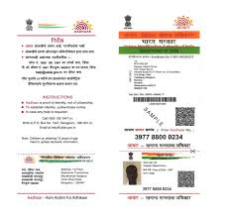
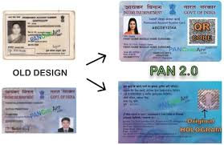
Home
Level 1 employee Dashboard
 | Adhaar Card Front Page | Adhaar Card Back Page | PAN Front Page | PAN Back Page | Name As per Adhaar
Purchaser 1 |  |  |  |  | Mr ABCD EFGH
Purchaser 2 |  |  |  |  | Ms ADFEG RFEGH
Approve

Slide 84
Home
Level 1 employee Dashboard
Logout
Login ID | Date of Query | Subject | Details | Attachments | Response
9874563212 | 1 Mar 2025 | Unable to book | I have been trying to book a flat, but not able to | Screenshot | Try again
 | 1 Feb 2025 | Is this flat good | What amenities available in this flat |  | See the video
Send

Slide 85
Home
Level 4 employee Dashboard
Logout
Booking Amount Reconciliation Verifications
Payments Reconciliation Verification
Form 26QB and Form 16B Verification
Cancellation Refund Verification

Slide 86
Home
Level 4 employee Dashboard
Logout
Sl No | Project Name | Type of Property | Purchaser Name | Size of property | Date of Booking | Booking Fees | Booking Amount | Total Amount Paid | Mode of Payment | Date of Transaction | UTR Number | Approve / Reject
1 | Kannimanike Phase 1 | Flats | Asdafsd mgfdf | 1 BHK | 1 Jan 2025 | Rs 1,200 | Rs 2,50,000 | Rs 2,51,200 | Net Banking | 1 Jan 2025 | 1236547
2 | Kannimanike Phase 1 | Flats | Asdafsd mgfdf | 2 BHK | 1 Jan 2025 | Rs 1,200 | Rs 2,50,000 | 2,51,200 | Bank Branch RTGS | 1 Jan 2025 | 7896541
3 | Kannimanike Phase 1 | Flats | Asdafsd mgfdf | 3 BHK | 1 Jan 2025 | Rs 1,200 | Rs 2,50,000 | 2,51,200 | Bank Branch RTGS | 1 Jan 2025 | 2546879
4 | Kannimanike Phase 1 | Flats | Asdafsd mgfdf | 2 BHK | 1 Jan 2025 | Rs 1,200 | Rs 2,50,000 | 2,51,200 | Bank Branch RTGS | 1 Jan 2025 | 95123575
5 | Hunnegere Phase 1 | Villa | Asdafsd mgfdf | 3 BHK | 1 Jan 2025 | Rs 1,200 | Rs 2,50,000 | 2,51,200 | Net Banking | 1 Jan 2025 | 67198452
Verify
Verify
Verify
Verify
Verify
Ok

Slide 87
Home
Level 4 employee Dashboard
Logout
Project Details
Payment Details
Project Name | Kannimanike Phase1
Type of Property | Apartment
Size of property | 3 BHK
Flat Number | 709
Block | Block 3
Floor | 7 Floor
Date of Booking | 1 Jan 2025
Flat Cost | Rs 33,50,000
Parking and Amenities charge | Rs 2,50,000
Total Cost | Rs 36,00,000
Last date to Pay without Penalty | 1 Apr 2025
 | Application Fee | Booking Amount | Installment 1 | Installment 2 | Installment 3 | Installment 4 | Installment 5
Date of payment | 1 Jan 2025 | 1 Jan 2025
Amount paid | Rs 1200 | Rs 2,50,000
Mode of Payment | Bank Transfer | Offline RTGS
Bank | SBI | HDFC
Branch | Malleswaram | Malleswaram
IFSC | SBIN2154 | HDFC000125
Transaction Number | 12365487954 | 95874562315
Attachment
Purchaser | Mr Abcd Ghij
Adhaar | 98547 2563 2548
PAN | ACDG2654A
Application Fee Paid | Rs 1200
Booking Amount Paid | Rs 2,50,000
Balance Amount to be Paid | Rs 33,50,000
Challan
Verified

Slide 88
Home
Level 4 employee Dashboard
Logout
Sl No | Project Name | Type of Property | Purchaser Name | Size of property | Date of Booking | Booking Fees | Booking Amount | Total Amount Paid | Mode of Payment | Date of Transaction | UTR Number | Approve / Reject
1 | Kannimanike Phase 1 | Flats | Asdafsd mgfdf | 1 BHK | 1 Jan 2025 | Rs 1,200 | Rs 2,50,000 | Rs 2,51,200 | Net Banking | 1 Jan 2025 | 1236547
2 | Kannimanike Phase 1 | Flats | Asdafsd mgfdf | 2 BHK | 1 Jan 2025 | Rs 1,200 | Rs 2,50,000 | 2,51,200 | Bank Branch RTGS | 1 Jan 2025 | 7896541
3 | Kannimanike Phase 1 | Flats | Asdafsd mgfdf | 3 BHK | 1 Jan 2025 | Rs 1,200 | Rs 2,50,000 | 2,51,200 | Bank Branch RTGS | 1 Jan 2025 | 2546879
4 | Kannimanike Phase 1 | Flats | Asdafsd mgfdf | 2 BHK | 1 Jan 2025 | Rs 1,200 | Rs 2,50,000 | 2,51,200 | Bank Branch RTGS | 1 Jan 2025 | 95123575
5 | Hunnegere Phase 1 | Villa | Asdafsd mgfdf | 3 BHK | 1 Jan 2025 | Rs 1,200 | Rs 2,50,000 | 2,51,200 | Net Banking | 1 Jan 2025 | 67198452
Verify
Verify
Verify
Verify
Verify
Ok

Slide 89
Home
Level 4 employee Dashboard
Logout
Project Details
Payment Details
Project Name | Kannimanike Phase1
Type of Property | Apartment
Size of property | 3 BHK
Flat Number | 709
Block | Block 3
Floor | 7 Floor
Date of Booking | 1 Jan 2025
Flat Cost | Rs 33,50,000
Parking and Amenities charge | Rs 2,50,000
Total Cost | Rs 36,00,000
Last date to Pay without Penalty | 1 Apr 2025
 | Application Fee | Booking Amount | Installment 1 | Installment 2 | Installment 3 | Installment 4 | Installment 5
Date of payment | 1 Jan 2025 | 1 Jan 2025 | 1 Jan 2025 | 1 Jan 2025
Amount paid | Rs 1200 | Rs 2,50,000 | Rs 10,00,000 | Rs 5,00,000
Mode of Payment | Bank Transfer | Offline RTGS | Bank Transfer | Offline RTGS
Bank | SBI | HDFC | SBI | HDFC
Branch | Malleswaram | Malleswaram | Malleswaram | Malleswaram
IFSC | SBIN2154 | HDFC000125 | SBIN2154 | HDFC000125
Transaction Number | 12365487954 | 95874562315 | 12365487954 | 95874562315
Attachment
Document Shared / Uploaded
Purchaser | Mr Abcd Ghij
Adhaar | 98547 2563 2548
PAN | ACDG2654A
Application Fee Paid | Rs 1200
Booking Amount Paid | Rs 2,50,000
Balance Amount to be Paid | Rs 15,50,000
Challan
Challan
Challan
NoC
Allotment letter
Verified

Slide 90
Home
Level 4 employee Dashboard
Logout
Sl No | Project Name | Type of Property | Purchaser Name | Total Cost of the Project | Full Amount Paid | Date of Final Payment | Total Amount Paid |  | Approve / Reject
1 | Kannimanike Phase 1 | Flats | Asdafsd mgfdf | Rs 2,50,000 | Yes | 1 Jan 2025 | Rs 2,50,000
2 | Kannimanike Phase 1 | Flats | Asdafsd mgfdf | Rs 2,50,000 | Yes | 1 Jan 2025 | Rs 2,50,000
3 | Kannimanike Phase 1 | Flats | Asdafsd mgfdf | Rs 2,50,000 | Yes | 1 Jan 2025 | Rs 2,50,000
4 | Kannimanike Phase 1 | Flats | Asdafsd mgfdf | Rs 2,50,000 | Yes | 1 Jan 2025 | Rs 2,50,000
5 | Hunnegere Phase 1 | Villa | Asdafsd mgfdf | Rs 2,50,000 | Yes | 1 Jan 2025 | Rs 2,50,000
Verify
Verify
Verify
Verify
Verify
Ok

Slide 91
Home
Level 4 employee Dashboard
Logout
Project Details
Payment Details
Project Name | Kannimanike Phase1
Type of Property | Apartment
Size of property | 3 BHK
Flat Number | 709
Block | Block 3
Floor | 7 Floor
Date of Booking | 1 Jan 2025
Flat Cost | Rs 33,50,000
Parking and Amenities charge | Rs 2,50,000
Total Cost | Rs 36,00,000
Last date to Pay without Penalty | 1 Apr 2025
 | Application Fee | Booking Amount | Installment 1 | Installment 2 | Installment 3 | Installment 4 | Installment 5
Date of payment | 1 Jan 2025 | 1 Jan 2025 | 1 Jan 2025 | 1 Jan 2025 | 1 Jan 2025 | 1 Jan 2025 | 1 Jan 2025
Amount paid | Rs 1200 | Rs 2,50,000 | Rs 10,00,000 | Rs 5,00,000 | Rs 5,00,000 | Rs 5,00,000 | Rs 5,00,000
Mode of Payment | Bank Transfer | Offline RTGS | Bank Transfer | Offline RTGS | Offline RTGS | Offline RTGS | Offline RTGS
Bank | SBI | HDFC | SBI | HDFC | HDFC | HDFC | HDFC
Branch | Malleswaram | Malleswaram | Malleswaram | Malleswaram | Malleswaram | Malleswaram | Malleswaram
IFSC | SBIN2154 | HDFC000125 | SBIN2154 | HDFC000125 | HDFC000125 | HDFC000125 | HDFC000125
Transaction Number | 12365487954 | 95874562315 | 12365487954 | 95874562315 | 95874562315 | 95874562315 | 95874562315
Attachment
Document Shared / Uploaded
Forms Uploaded by Customer
Challan
Challan
Challan
Challan
Challan
Challan
Purchaser | Mr Abcd Ghij
Adhaar | 98547 2563 2548
PAN | ACDG2654A
Application Fee Paid | Rs 1200
Booking Amount Paid | Rs 2,50,000
Balance Amount to be Paid | 0
NoC
Allotment letter
26QB
16B
Verified

Slide 92
Home
Level 4 employee Dashboard
Logout
Sl No | Project Name | Type of Property | Purchaser Name | Size of property | Date of Booking | Total Amount Paid So far | L1 Employee Approval Date | L2 Employee Approval Date | L3 Employee Approval Date | Approve / Reject
1 | Kannimanike Phase 1 | Flats | Asdafsd mgfdf | 1 BHK | 1 Jan 2025 | Rs 1,200 | 1 Jan 2025 | 15 Jan 2025 | 30 Jan 2025
2 | Kannimanike Phase 1 | Flats | Asdafsd mgfdf | 2 BHK | 1 Jan 2025 | Rs 1,200 | 1 Jan 2025 | 15 Jan 2025 | 30 Jan 2025
3 | Kannimanike Phase 1 | Flats | Asdafsd mgfdf | 3 BHK | 1 Jan 2025 | Rs 1,200 | 1 Jan 2025 | 15 Jan 2025 | 30 Jan 2025
4 | Kannimanike Phase 1 | Flats | Asdafsd mgfdf | 2 BHK | 1 Jan 2025 | Rs 1,200 | 1 Jan 2025 | 15 Jan 2025 | 30 Jan 2025
5 | Hunnegere Phase 1 | Villa | Asdafsd mgfdf | 3 BHK | 1 Jan 2025 | Rs 1,200 | 1 Jan 2025 | 15 Jan 2025 | 30 Jan 2025
Verify
Verify
Verify
Verify
Verify
Ok

Slide 93
Home
Level 4 employee Dashboard
Logout
Project Details
Payment Details
Project Name | Kannimanike Phase1
Type of Property | Apartment
Size of property | 3 BHK
Flat Number | 709
Block | Block 3
Floor | 7 Floor
Date of Booking | 1 Jan 2025
Flat Cost | Rs 33,50,000
Parking and Amenities charge | Rs 2,50,000
Total Cost | Rs 36,00,000
Last date to Pay without Penalty | 1 Apr 2025
 | Application Fee | Booking Amount | Installment 1 | Installment 2 | Installment 3 | Installment 4 | Installment 5
Date of payment | 1 Jan 2025 | 1 Jan 2025
Amount paid | Rs 1200 | Rs 2,50,000
Mode of Payment | Bank Transfer | Offline RTGS
Bank | SBI | HDFC
Branch | Malleswaram | Malleswaram
IFSC | SBIN2154 | HDFC000125
Transaction Number | 12365487954 | 95874562315
Attachment
Purchaser | Mr Abcd Ghij
Adhaar | 98547 2563 2548
PAN | ACDG2654A
Application Fee Paid | Rs 1200
Booking Amount Paid | Rs 2,50,000
Balance Amount to be Paid | Rs 33,50,000
Challan
Verified

Slide 94
Home
Level 5 employee Dashboard
Logout
Approve Payments Reconciliation Verification
Approve Form 26QB and Form 16B Verification
Approve Cancellation Refund Verification

Slide 95
Home
Level 4 employee Dashboard
Logout
Sl No | Project Name | Type of Property | Purchaser Name | Size of property | Amount paid | Mode of Payment | Date of Transaction | UTR Number | Verification done By | Verification Date | Details | Approve / Reject
1 | Kannimanike Phase 1 | Flats | Asdafsd mgfdf | 1 BHK | Rs 2,51,200 | Net Banking | 1 Jan 2025 | 1236547 | L1 empl | 15 Jan 2025
2 | Kannimanike Phase 1 | Flats | Asdafsd mgfdf | 2 BHK | Rs 2,51,200 | Bank Branch RTGS | 1 Jan 2025 | 7896541 | L1 empl | 15 Jan 2025
3 | Kannimanike Phase 1 | Flats | Asdafsd mgfdf | 3 BHK | Rs 2,51,200 | Bank Branch RTGS | 1 Jan 2025 | 2546879 | L1 empl | 15 Jan 2025
4 | Kannimanike Phase 1 | Flats | Asdafsd mgfdf | 2 BHK | Rs 2,51,200 | Bank Branch RTGS | 1 Jan 2025 | 95123575 | L1 empl | 15 Jan 2025
5 | Hunnegere Phase 1 | Villa | Asdafsd mgfdf | 3 BHK | Rs 2,51,200 | Net Banking | 1 Jan 2025 | 67198452 | L1 empl | 15 Jan 2025
Details
Approve
Details
Approve
Details
Approve
Details
Approve
Details
Approve
Ok

Slide 96
Home
Level 4 employee Dashboard
Logout
Project Details
Payment Details
Project Name | Kannimanike Phase1
Type of Property | Apartment
Size of property | 3 BHK
Flat Number | 709
Block | Block 3
Floor | 7 Floor
Date of Booking | 1 Jan 2025
Flat Cost | Rs 33,50,000
Parking and Amenities charge | Rs 2,50,000
Total Cost | Rs 36,00,000
Last date to Pay without Penalty | 1 Apr 2025
 | Application Fee | Booking Amount | Installment 1 | Installment 2 | Installment 3 | Installment 4 | Installment 5
Date of payment | 1 Jan 2025 | 1 Jan 2025 | 1 Jan 2025 | 1 Jan 2025
Amount paid | Rs 1200 | Rs 2,50,000 | Rs 10,00,000 | Rs 5,00,000
Mode of Payment | Bank Transfer | Offline RTGS | Bank Transfer | Offline RTGS
Bank | SBI | HDFC | SBI | HDFC
Branch | Malleswaram | Malleswaram | Malleswaram | Malleswaram
IFSC | SBIN2154 | HDFC000125 | SBIN2154 | HDFC000125
Transaction Number | 12365487954 | 95874562315 | 12365487954 | 95874562315
Attachment
Document Shared / Uploaded
Purchaser | Mr Abcd Ghij
Adhaar | 98547 2563 2548
PAN | ACDG2654A
Application Fee Paid | Rs 1200
Booking Amount Paid | Rs 2,50,000
Balance Amount to be Paid | Rs 15,50,000
Challan
Challan
Challan
NoC
Allotment letter
Approve

Slide 97
Home
Level 4 employee Dashboard
Logout
Sl No | Project Name | Type of Property | Purchaser Name | Total Cost of the Project | Full Amount Paid | Date of Final Payment | Total Amount Paid |  | Approve / Reject
1 | Kannimanike Phase 1 | Flats | Asdafsd mgfdf | Rs 2,50,000 | Yes | 1 Jan 2025 | Rs 2,50,000
2 | Kannimanike Phase 1 | Flats | Asdafsd mgfdf | Rs 2,50,000 | Yes | 1 Jan 2025 | Rs 2,50,000
3 | Kannimanike Phase 1 | Flats | Asdafsd mgfdf | Rs 2,50,000 | Yes | 1 Jan 2025 | Rs 2,50,000
4 | Kannimanike Phase 1 | Flats | Asdafsd mgfdf | Rs 2,50,000 | Yes | 1 Jan 2025 | Rs 2,50,000
5 | Hunnegere Phase 1 | Villa | Asdafsd mgfdf | Rs 2,50,000 | Yes | 1 Jan 2025 | Rs 2,50,000
Verify
Verify
Verify
Verify
Verify
Ok

Slide 98
Home
Level 4 employee Dashboard
Logout
Project Details
Payment Details
Project Name | Kannimanike Phase1
Type of Property | Apartment
Size of property | 3 BHK
Flat Number | 709
Block | Block 3
Floor | 7 Floor
Date of Booking | 1 Jan 2025
Flat Cost | Rs 33,50,000
Parking and Amenities charge | Rs 2,50,000
Total Cost | Rs 36,00,000
Last date to Pay without Penalty | 1 Apr 2025
 | Application Fee | Booking Amount | Installment 1 | Installment 2 | Installment 3 | Installment 4 | Installment 5
Date of payment | 1 Jan 2025 | 1 Jan 2025 | 1 Jan 2025 | 1 Jan 2025 | 1 Jan 2025 | 1 Jan 2025 | 1 Jan 2025
Amount paid | Rs 1200 | Rs 2,50,000 | Rs 10,00,000 | Rs 5,00,000 | Rs 5,00,000 | Rs 5,00,000 | Rs 5,00,000
Mode of Payment | Bank Transfer | Offline RTGS | Bank Transfer | Offline RTGS | Offline RTGS | Offline RTGS | Offline RTGS
Bank | SBI | HDFC | SBI | HDFC | HDFC | HDFC | HDFC
Branch | Malleswaram | Malleswaram | Malleswaram | Malleswaram | Malleswaram | Malleswaram | Malleswaram
IFSC | SBIN2154 | HDFC000125 | SBIN2154 | HDFC000125 | HDFC000125 | HDFC000125 | HDFC000125
Transaction Number | 12365487954 | 95874562315 | 12365487954 | 95874562315 | 95874562315 | 95874562315 | 95874562315
Attachment
Document Shared / Uploaded
Forms Uploaded by Customer
Challan
Challan
Challan
Challan
Challan
Challan
Purchaser | Mr Abcd Ghij
Adhaar | 98547 2563 2548
PAN | ACDG2654A
Application Fee Paid | Rs 1200
Booking Amount Paid | Rs 2,50,000
Balance Amount to be Paid | 0
NoC
Allotment letter
26QB
16B
Verified

Slide 99
Home
Level 4 employee Dashboard
Logout
Sl No | Project Name | Type of Property | Purchaser Name | Size of property | Date of Booking | Booking Fees | Booking Amount | Total Amount Paid | Mode of Payment | Date of Transaction | UTR Number | Approve / Reject
1 | Kannimanike Phase 1 | Flats | Asdafsd mgfdf | 1 BHK | 1 Jan 2025 | Rs 1,200 | Rs 2,50,000 | Rs 2,51,200 | Net Banking | 1 Jan 2025 | 1236547
2 | Kannimanike Phase 1 | Flats | Asdafsd mgfdf | 2 BHK | 1 Jan 2025 | Rs 1,200 | Rs 2,50,000 | 2,51,200 | Bank Branch RTGS | 1 Jan 2025 | 7896541
3 | Kannimanike Phase 1 | Flats | Asdafsd mgfdf | 3 BHK | 1 Jan 2025 | Rs 1,200 | Rs 2,50,000 | 2,51,200 | Bank Branch RTGS | 1 Jan 2025 | 2546879
4 | Kannimanike Phase 1 | Flats | Asdafsd mgfdf | 2 BHK | 1 Jan 2025 | Rs 1,200 | Rs 2,50,000 | 2,51,200 | Bank Branch RTGS | 1 Jan 2025 | 95123575
5 | Hunnegere Phase 1 | Villa | Asdafsd mgfdf | 3 BHK | 1 Jan 2025 | Rs 1,200 | Rs 2,50,000 | 2,51,200 | Net Banking | 1 Jan 2025 | 67198452
Verify
Verify
Verify
Verify
Verify
Ok

Slide 100
Home
Level 4 employee Dashboard
Logout
Sl No | Project Name | Type of Property | Purchaser Name | Size of property | Date of Booking | Total Amount Paid So far | L1 Employee Approval Date | L2 Employee Approval Date | L3 Employee Approval Date | L4 Employee Approval Date
1 | Kannimanike Phase 1 | Flats | Asdafsd mgfdf | 1 BHK | 1 Jan 2025 | Rs 1,200 | 1 Jan 2025 | 15 Jan 2025 | 30 Jan 2025 | 10 Feb 2025
2 | Kannimanike Phase 1 | Flats | Asdafsd mgfdf | 2 BHK | 1 Jan 2025 | Rs 1,200 | 1 Jan 2025 | 15 Jan 2025 | 30 Jan 2025 | 10 Feb 2025
3 | Kannimanike Phase 1 | Flats | Asdafsd mgfdf | 3 BHK | 1 Jan 2025 | Rs 1,200 | 1 Jan 2025 | 15 Jan 2025 | 30 Jan 2025 | 10 Feb 2025
4 | Kannimanike Phase 1 | Flats | Asdafsd mgfdf | 2 BHK | 1 Jan 2025 | Rs 1,200 | 1 Jan 2025 | 15 Jan 2025 | 30 Jan 2025 | 10 Feb 2025
5 | Hunnegere Phase 1 | Villa | Asdafsd mgfdf | 3 BHK | 1 Jan 2025 | Rs 1,200 | 1 Jan 2025 | 15 Jan 2025 | 30 Jan 2025 | 10 Feb 2025
Approve
Approve
Approve
Approve
Approve
Ok

Slide 101
Home
Admin Module
Logout
Sl No | Employee Name | Designation | Role in the System |  |  |  |  | Delete
1 | Mr Abcde | Case Worker
2 | Mr Gdfc | Senior Manager
3 | Mrs Pqrst | Additional Commissioner
4 | Ms Klimn | Finance Cleric
5 | Mr Opqurst | Finance Head
L1 | L2 | L3 | L4 | L5
Delete Selected
Create a new
Generate A Report

